Slide 1
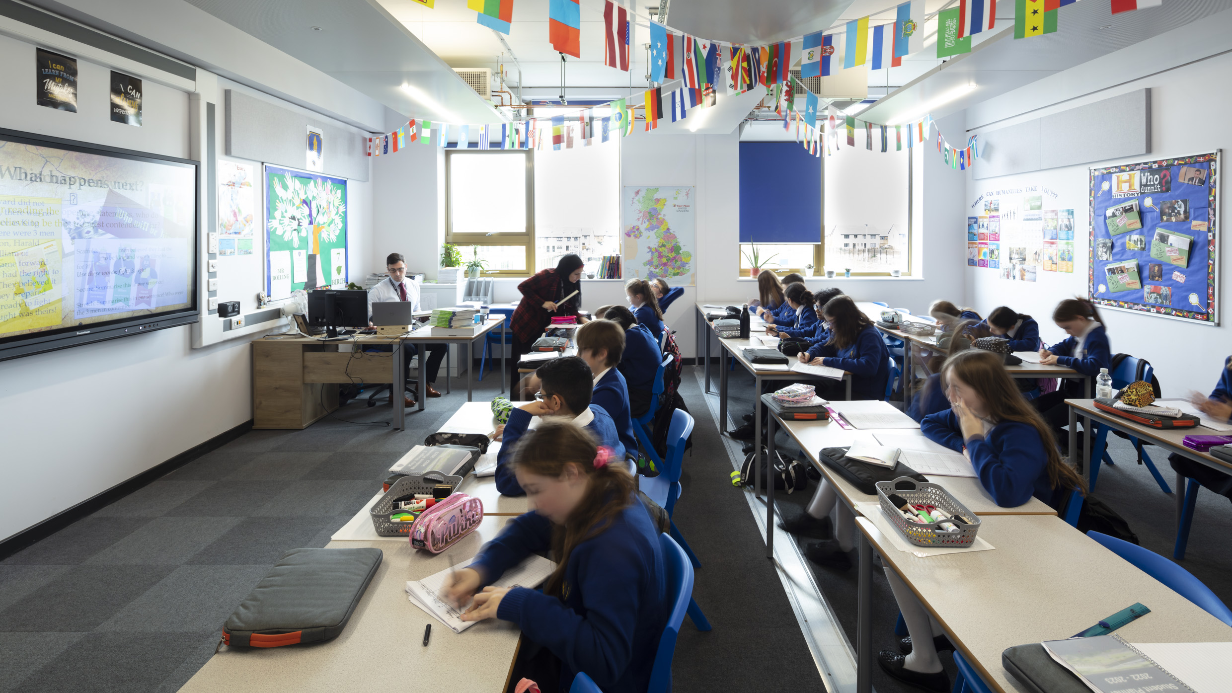
Your journey to GCSEs
Shaping your future
Notes:
I’m really excited to talk to you today about an important milestone in your education: choosing your GCSE options. While we’re not going into the specific details of your options just yet, today is about understanding what GCSEs are, why they’re important, and what lies ahead for you as you move into Key Stage 4.
This is a big step in your school journey. It’s a chance to shape your future and begin focusing on the areas of study that will open doors for you later in life. But before we dive in, let’s get one thing clear: this is your opportunity to take your education seriously and to start preparing for the world beyond school.

Slide 2

What are GCSEs?
GCSE stands for General Certificate of Secondary Education. They are the qualifications you’ll study for in Years 10 and 11, and they are a vital part of your education.
At GCSE level, you’ll study a mix of core subjects—the ones everyone takes—and optional subjects, which you’ll get to choose based on your interests and goals.
Notes:
GCSE stands for General Certificate of Secondary Education. They are the qualifications you’ll study for in Years 10 and 11, and they are a vital part of your education. Your GCSE results will stay with you for life—they’re what colleges, universities, apprenticeships, and employers will look at to understand what kind of person you are, what you’re capable of, and how determined you can be.
At GCSE level, you’ll study a mix of core subjects—the ones everyone takes—and optional subjects, which you’ll get to choose based on your interests and goals.

Slide 3







The Core Subjects
GCSE’s everyone will study:
English Language & Literature
You’ll develop the skills to communicate effectively, analyse texts, and express yourself clearly—skills that are important no matter what career you choose.
English
Maths
Science
RE
Citzenship
RSE
PE
Mathematics
Maths is about solving problems and thinking logically—skills you’ll need in everyday life and in almost any job you might consider.
Science
Science is all about curiosity and understanding the world around us. Whether it’s biology, chemistry, or physics, science helps you develop critical thinking and problem-solving skills.

Slide 4
The Core Subjects
Other Core subjects:
Religion, philosophy & ethics
You’ll explore beliefs, values, and the ethical issues that shape our world. It’s a chance to develop respect and understanding for others.
English
Maths
Science
RE
Citizenship
RSE
PE
Citizenship, Careers, Relationships & Sex Education
These subjects prepare you for life beyond school—teaching you about careers, finances, relationships, and being an active, informed citizen.
PE
You will still have regular opportunities to play sports and exercise. This is great for your wellbeing both physically and mentally, and can help you ease any exam tension.

Slide 5

Why These Subjects Matter
These core areas give you the skills, knowledge, and confidence you need to succeed—not just at school but in life.
Think of your education like a toolbox. Each subject adds a different tool:
English gives you the ability to communicate.
Maths equips you to solve problems.
Science teaches you to ask questions and find answers.
RE and Citizenship make you a well-rounded, informed member of society.
When you combine these tools, you’re ready for anything.
Notes:
These core areas give you the skills, knowledge, and confidence you need to succeed—not just at school but in life. Employers and colleges want people who can think critically, communicate well, and work effectively as part of a team. GCSEs help you build those abilities.

Slide 6

What else will I study?
You will study FOUR other subjects and most students will achieve at least NINE GCSEs or equivalent at the end of year 11.
You will be able to make some choices about what you would prefer to study, but teachers will have the final decision about if you are suitable for a course or not.

Slide 7

Taking it seriously
GCSEs aren’t just about passing exams—they’re about setting yourself up for a future full of opportunities.
This is your chance to show what you’re capable of. But it’s not just about hard work—it’s about working smart.
You might not know what you want to do in the future yet, and that’s okay. The important thing is to give yourself as many options as possible.
Notes:
GCSEs aren’t just about passing exams—they’re about setting yourself up for a future full of opportunities. The effort you put in now will pay off later, whether you want to go to college, start an apprenticeship, or get a job straight after school.
This is your chance to show what you’re capable of. But it’s not just about hard work—it’s about working smart. Use your time wisely, listen to your teachers, and start thinking about what motivates you.
You might not know what you want to do in the future yet, and that’s okay. The important thing is to give yourself as many options as possible.

Slide 8

What happens next?
Information about available options (Dec/Jan)
Options booklet sent home (Dec/Jan)
KS4 information evening for students & families (Feb)
Deadline to make choices/second choices (Feb half term)
Told about final subject (Summer)
Begin KS4! (September)
Notes:
In the coming weeks, we’ll be talking more about the specific subjects you can choose. You’ll get advice and guidance from your teachers and even some careers professionals to help you make informed decisions.
For now, I want you to start thinking about your strengths and interests. What do you enjoy? What do you want to achieve? And most importantly, how can you make the most of the opportunities you’ll have during Key Stage 4?

Slide 9

Final Thoughts:
Your education is yours. The decisions you make now will shape your future. Take pride in your work, ask for help when you need it, and don’t be afraid to challenge yourself.
Remember, this is your chance to grow, to explore, and to take control of your journey. We’re here to support you every step of the way, but the effort has to come from you.
Notes:
Let me leave you with this: your education is yours. The decisions you make now will shape your future. Take pride in your work, ask for help when you need it, and don’t be afraid to challenge yourself.
Remember, this is your chance to grow, to explore, and to take control of your journey. We’re here to support you every step of the way, but the effort has to come from you.
Thank you for listening, and I can’t wait to see how you embrace this next chapter of your education.
Have a great day!

